Slide 1
“Who do people say the Son of Man is?”
Portraits of Jesus

Slide 2
Matthew
Most important objectives
Demonstrate Jesus’ credentials as Israel’s true Messiah
Presenting Jesus as the supreme teacher and interpreter of the Mosaic Torah
Instructing the community–the church–in the kind of correct belief and behavior that will ensure Jesus’ approval when he returns
(Harris 153)

Slide 3
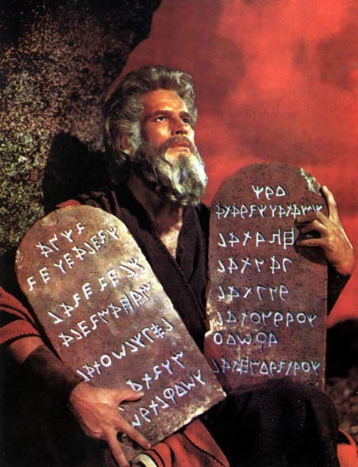
Matthew
Greater than Moses
(Harris)
Being typed as Moses gives authenticity (Allison 47).
A New Moses – Matthew’s typology
Typology is commonly used literary technique of biographical comparisons
This was a common practice in the Jewish Bible
1 and 2 Kings, David is often the paradigm by which kings are evaluated
a comparison of Genesis 1:26-31 with 9:1-7 and 3:17 with 5:29 depicts Noah as another Adam
Jesus fasts and goes into a mountain like Moses
http://img.dailymail.co.uk/i/pix/2008/03_01/mosesHeston2703_468x611.jpg

Slide 4
Matthew & Moses
The infancy narrative has five of the six links that tie the passage to Moses.
Explicit statement—Matthew 2:15 quotes Hosea 11:1.
Implicit citation—2:19-21 depends on Exodus 4:19-20.
Similar circumstance—pages 144-146 lists eleven comparable circumstance between the stories of Moses and Jesus.
Key words and phrases—five similar phrases that Matthew shares with Exodus.
Similar narrative structure—Matthew 1:18-2:23 has a tripartite structure that is compared to Josephus’ account of Moses’ infancy in Antiquities 2:205-23.
(Allison 142-148)

Slide 5
The New Moses
“Jesus is the Moses-like Messiah who proclaims the eschatological will of God on a mountain typologically equated with Sinai.”
(Allison 185)
Sermon on the Mount
Formula—You have heard it said; I say to you
Giving law with authority
²⁸When Jesus had finished saying these things, the crowds were amazed at his teaching, ²⁹ because he taught as one who had authority, and not as their teachers of the law. (NIV; Matthew 7:28-29)

Slide 6
Jesus & the Law
Jesus came to fulfill the Law
¹⁷“Do not think that I have come to abolish the Law or the Prophets; I have not come to abolish them but to fulfill them. ¹⁸ I tell you the truth, until heaven and earth disappear, not the smallest letter, not the least stroke of a pen, will by any means disappear from the Law until everything is accomplished. ¹⁹ Anyone who breaks one of the least of these commandments and teaches others to do the same will be called least in the kingdom of heaven, but whoever practices and teaches these commands will be called great in the kingdom of heaven. ²⁰ For I tell you that unless your righteousness surpasses that of the Pharisees and the teachers of the law, you will certainly not enter the kingdom of heaven. (NIV; Mt 5:17-20.)

Slide 7
Jesus as King

Slide 8
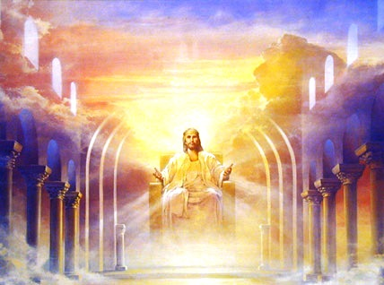
Matthew
Emphasis on Jesus as King
Robert L. Thomas
Descendant of David the King (1:1,6,17*)
Jesus is called “King of the Jews (2:2, 11*)
John preached that the kingdom was near (3:2-3*)
Jesus preached the gospel of the kingdom (4:23*)
Jesus’ triumphal entry into Jerusalem (21:1-5, 9)
http://mudpreacher.files.wordpress.com/2008/02/jesus_king_1.jpg
* Indicates no parallel in the other Gospels

Slide 9
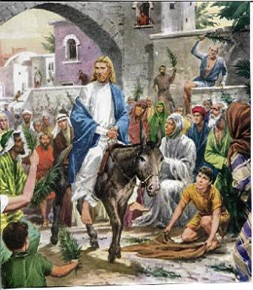
Triumphal Entry
As they approached Jerusalem and came to Bethphage on the Mount of Olives, Jesus sent two disciples, ² saying to them, “Go to the village ahead of you, and at once you will find a donkey tied there, with her colt by her. Untie them and bring them to me. ³ If anyone says anything to you, tell him that the Lord needs them, and he will send them right away.”
⁴ This took place to fulfill what was spoken through the prophet:
⁵ “Say to the Daughter of Zion,
‘See, your king comes to you,
gentle and riding on a donkey,
on a colt, the foal of a donkey.’ ”
(quoting Zachariah 9:9)
Matthew 21:1-5

Slide 10
Jesus as Messiah

Slide 11
The terms
Messiah—Jewish
The “anointed one”
Designating a king or priest of ancient Israel
Χριστός—Christian
Anointed One
Commonly translated as “the Christ”

Slide 12
Jewish concept
The word "mashiach" does not mean "savior." The notion of an innocent, divine or semi-divine being who will sacrifice himself to save us from the consequences of our own sins is a purely Christian concept that has no basis in Jewish thought. Unfortunately, this Christian concept has become so deeply ingrained in the English word "messiah" that this English word can no longer be used to refer to the Jewish concept.
(Tracey R. Rich 2009. Judaism 101. 2009. http://www.jewfaq.org/mashiach.htm (accessed December 31, 2009))

Slide 13
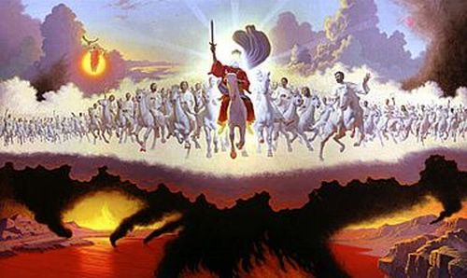
Matthew’s Perspective
http://revlu.com/images/Jesus/return.jpg
Called the Christ in the genealogy (1:16)
Virgin conception trumps the Davidic bloodline (Robert Imperato, Portraits of Jesus, 19)
Named Jesus because he will save his people (1:21)

Slide 14
Jesus as Founder of the Church

Slide 15
Founder of the Church
¹³ When Jesus came to the region of Caesarea Philippi, he asked his disciples, “Who do people say the Son of Man is?”
¹⁴ They replied, “Some say John the Baptist; others say Elijah; and still others, Jeremiah or one of the prophets.”
¹⁵ “But what about you?” he asked. “Who do you say I am?”
¹⁶ Simon Peter answered, “You are the Christ,﻿﻿ the Son of the living God.”
¹⁷ Jesus replied, “Blessed are you, Simon son of Jonah, for this was not revealed to you by man, but by my Father in heaven. ¹⁸ And I tell you that you are Peter,﻿ and on this rock I will build my church, and the gates of Hades﻿﻿ will not overcome it.﻿ ¹⁹ I will give you the keys of the kingdom of heaven; whatever you bind on earth will be﻿﻿ bound in heaven, and whatever you loose on earth will be﻿﻿ loosed in heaven.”
Matthew 16:13-19

Slide 16
Matthew & the Church
Two reasons for Matthew being the first gospel in the canon?
More extensive coverage of Jesus’ teachings, making it the church’s major resource in instructing its members
Important to church leaders because it is the Gospel most explicitly concerned with the nature and function of the church
(Harris 153)

Slide 17
Works Cited
Allison, Jr., Dale C. The New Moses: A Matthean Typology. Minneapolis: Fortress Press, 1993. Print.
Harris, Stephen L. The New Testament: A Student’s Introduction. Sixth ed. Boston: McGraw Hill, 1988-2009. Print.

